Slide 1
Log Triage Tool Overview Intelligent Log Analysis and Visualization
Johnson Amalraj
Last updated on 17-July-2025

Slide 2
Agenda
Why Log Triage Tool?
Features
How to use
Future Ideas to consider

Slide 3
Why Log Triage Tool?
Manual log review is time-consuming and error-prone.
A smart triage tool can dramatically reduce debugging time.
This tool is designed to assist in triaging and analyzing regression log files efficiently.
Supports multi-user collaboration, exclusion management and session persistence.

Slide 4
Features
Folder-based log loading (*.log, *.log.gz)
PyQt5-based interface with table view with per-column filtering, multi-column sorting and search capabilities
Regex-based pattern (json) detection (ERROR, WARNING, FATAL) from multiple EDA tools
Resizable columns and persistent settings
Cleans messages for grouping and analysis
Exclusion and user comments management for all row and per-row
Context menus and keyboard shortcuts
Visualizations: Pie chart & Bar chart
Dark/Light mode support

Slide 5
Steps to follow
How to use ?
Run Command:
bsub -R "rUsage[RAM=10000]" python3 logtriage.py
Required packages:
PyQt5, matplotlib, psutil, numpy
Package installation steps:
pip3 install <pkg_name>
Requirement: Python 3.7+
Load
Load log folder or saved sessions
View
Filter or sort and view only required details
Exclusions
Apply exclusions, and export/import into any sessions
Comments
Add multi-user comments and save session with comments
Export and visualize
Export summary/session/exclusion into JSON and visualize in charts
Save/load
Save/load session

Slide 6
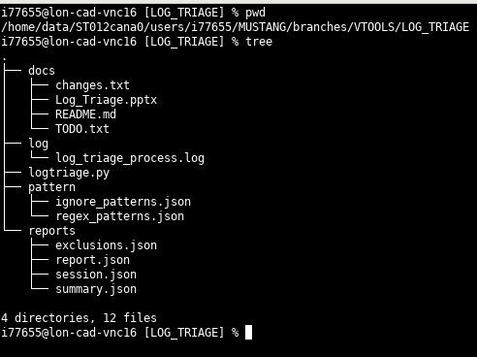
To Evaluate
use the following command to export to your local folder or create the DB in your machine
Folder Structure
svn export https://lon-cad-svn.microchip.com/repo/mpu32verification/MPU_VTOOLS/branches/MUSTANG_ST012_A0/LOG_TRIAGE

Slide 7
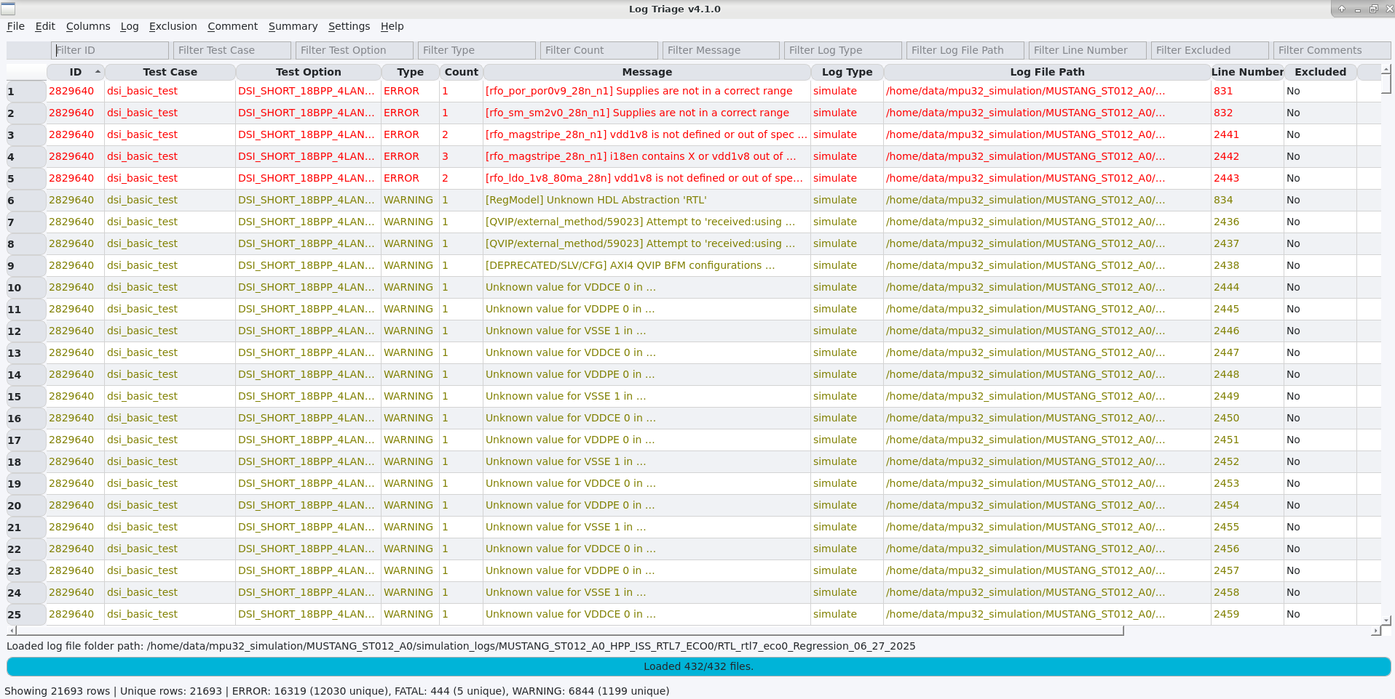
User Interface Overview
Table View: Parsed log messages
Filter Row: Per-column filtering
Menus: File, Edit, Columns, Exclusion, Log, Exclusion, Comment, Summary, Settings, Help
Status Bar & Progress Bar : It displays the overall count for the loaded log files and loading status of log files

Slide 8
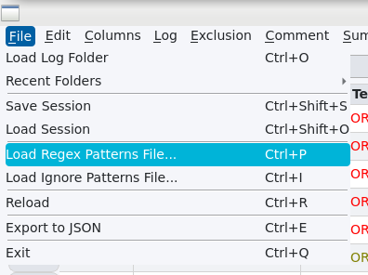
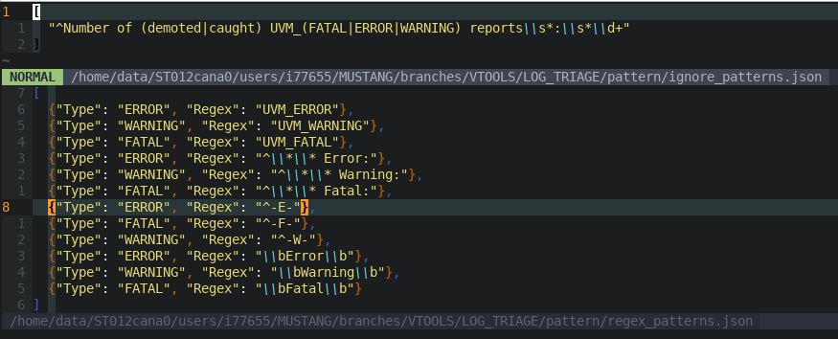
Pattern file
(regex & ignore pattern files)
Regex-based pattern detection (ERROR, WARNING, FATAL)
Ignore pattern support via JSON
(user can update the list or they can create their own file)

Slide 9
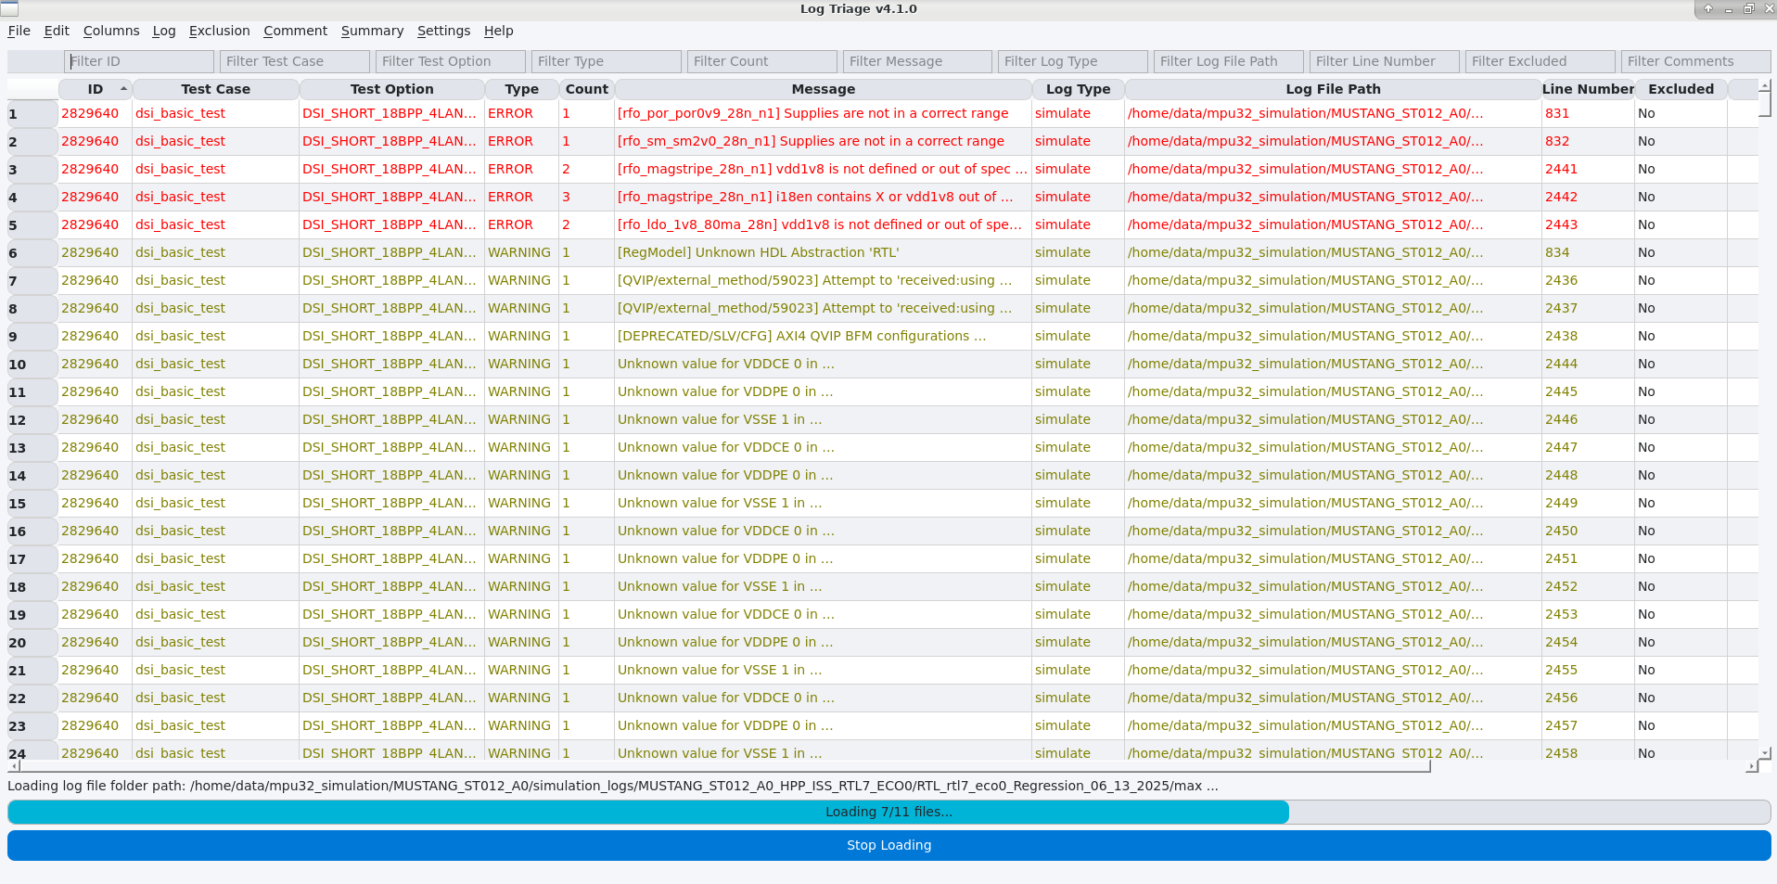
Loading Folders
User can be able to stop the loading in-between.
The stop Loading progress bar will automatically hide if folder/file is not loading to the tool

Slide 10
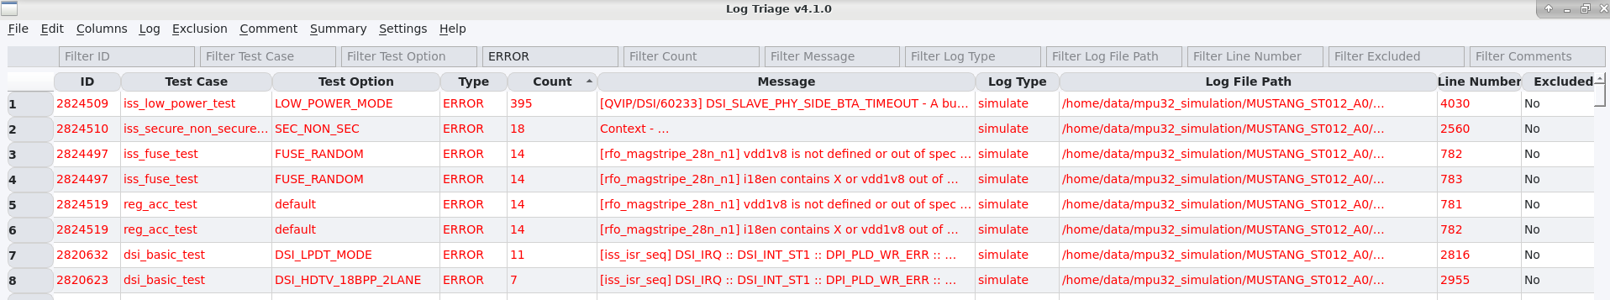
Filtering & Sorting
Filter any column (text, regex, numeric)
Multi-column sorting
Find dialog with regex support
Filter applied on ‘Message’ as ‘ERROR’; ‘Count’ column sorted.

Slide 11
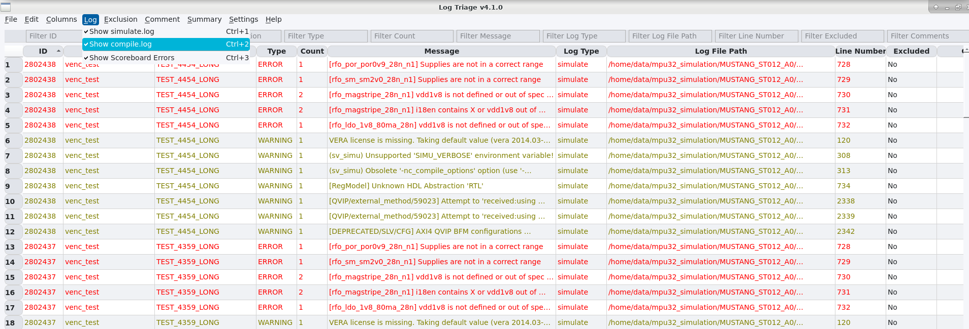
Log File Type and Scoreboard Errors
You can select which log files need to be loaded.
If you don’t want to see scoreboard errors, you can de-select that.

Slide 12
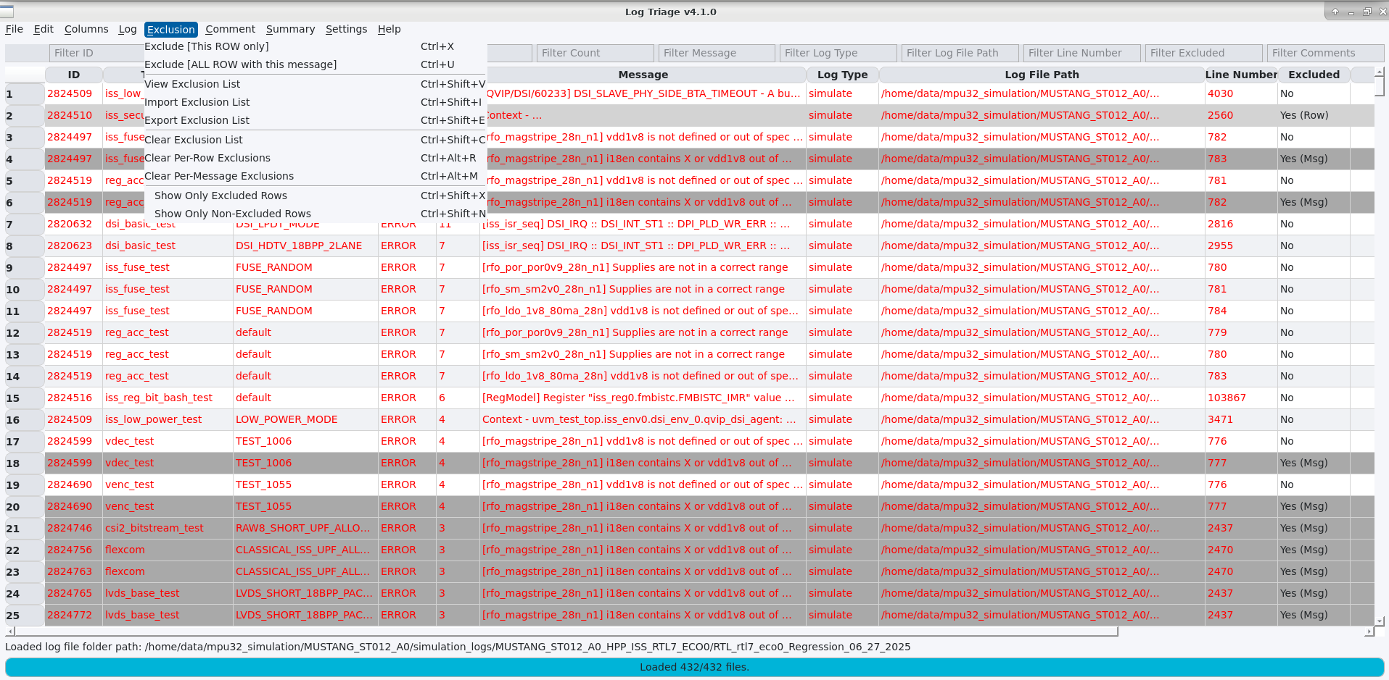
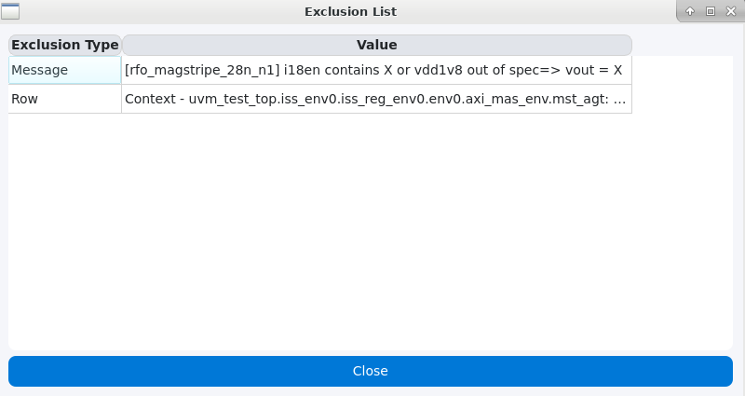
Exclusion
Add messages to exclusion list
Exclude messages per-row or per-message
View, import, export, clear exclusions
You can view the exclusion list as shown in the image (right side)
Show only excluded rows
Exclusion applied for the single row, and all row if same message present in other rows (Check Excluded Column)
You can view the excluded message

Slide 13
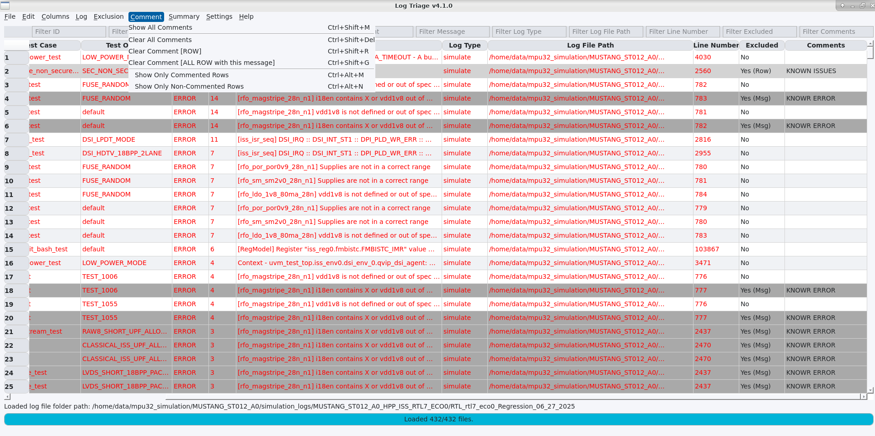
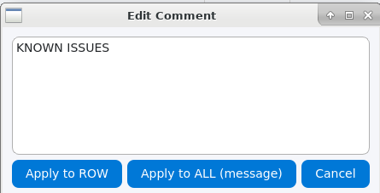
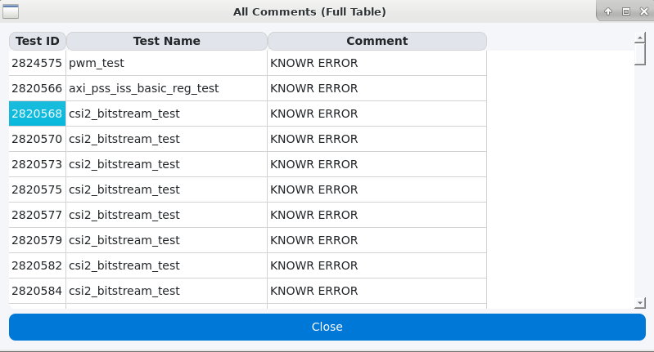
Comments
Add/edit per-row or all-row(if same message) comments by double-clicking the Comments cell
Added Comments are visible in the column
You can see the added comments
You can only see the table with comments only row
You can clear the comments also
Comments added for the single row, and all row if same message present in other rows (Check Comments Column)
Comments Edit Dialog with different options
All Added comments seen in the Dialog

Slide 14
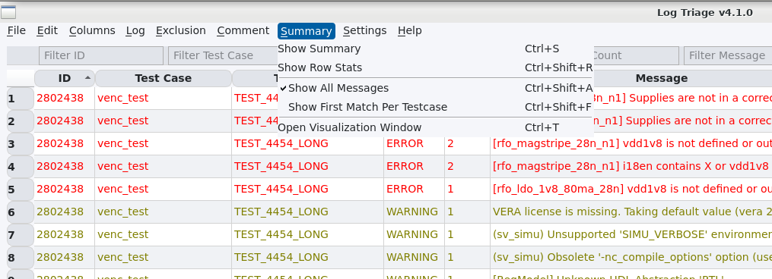
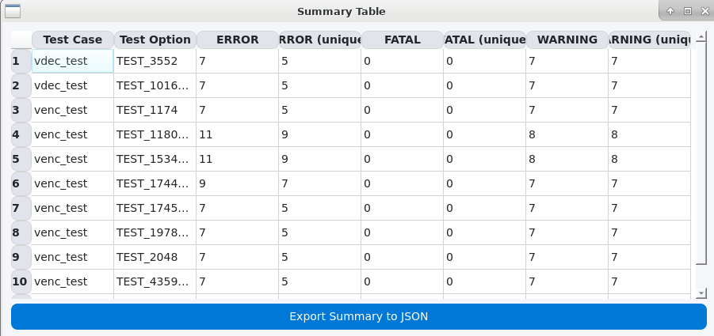
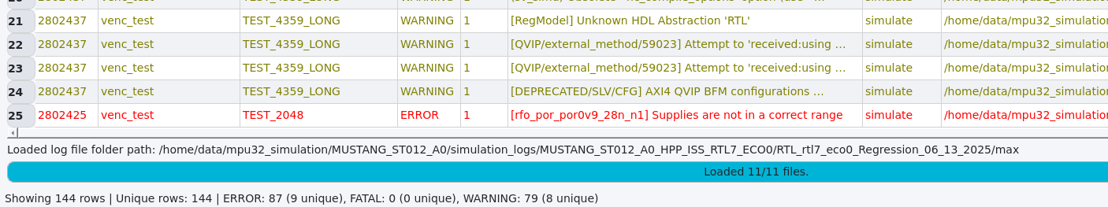
Summary
Show Summary: It will show the details for all test cases as below and can export to JSON
Shoe Row Stats: It will show at bottom of the tool with loading status and error counts along with the path of the loaded log files
You can view only the first message present in log(s) file.
Summary Menu options
Summary Table
Bottom of the tool show Row Stats

Slide 15
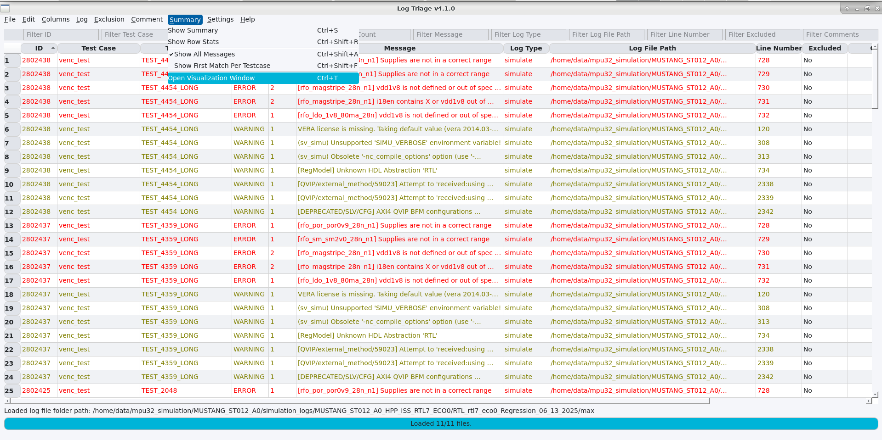
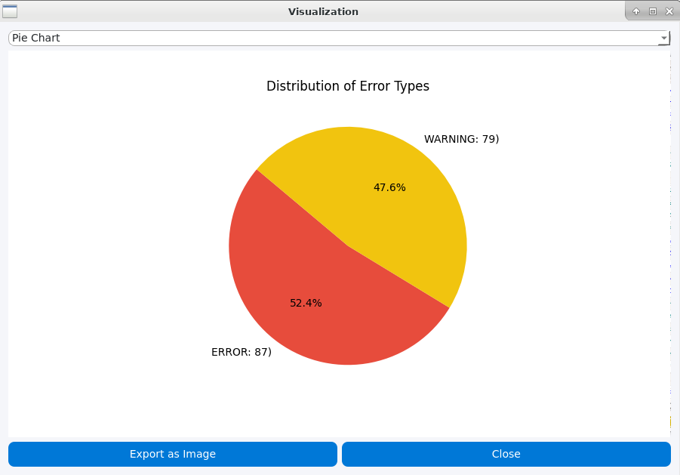
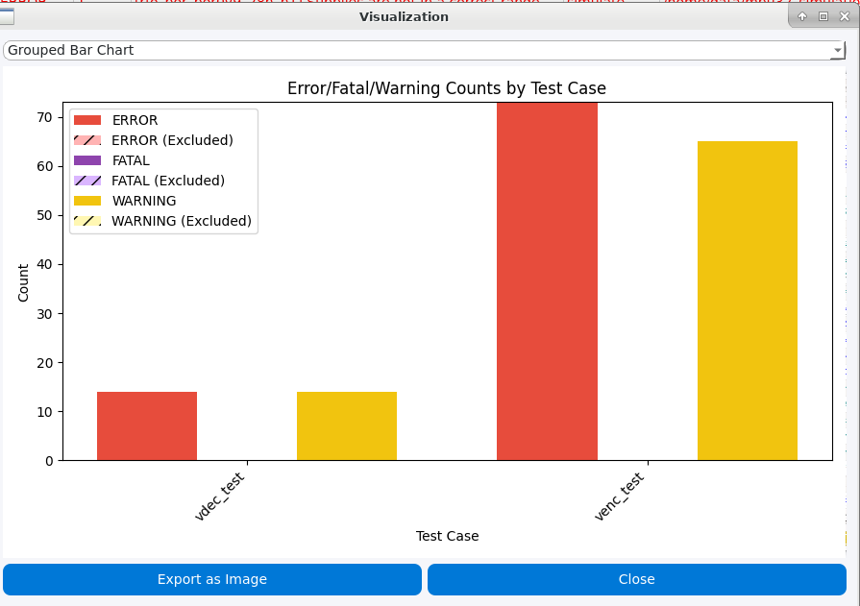
Visualization
You can view the details in the chart format (pie & bar)
You can export the chart as png image format
Supports Dark mode also

Slide 16
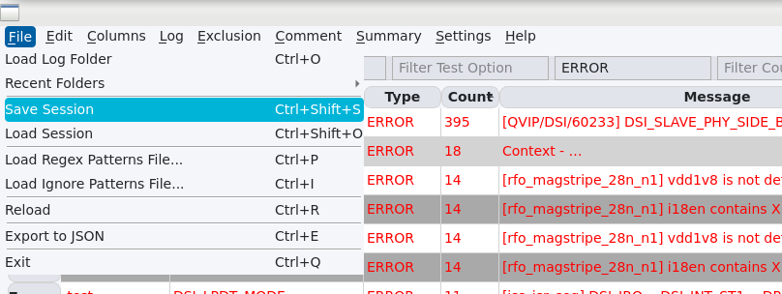
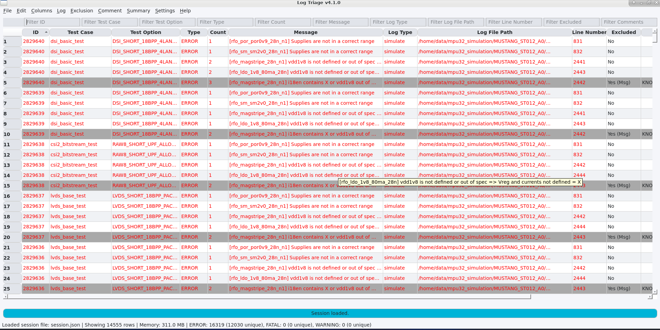
Session Management
Save/load session (includes comments and exclusions)
Session persistence helps in collaborative workflows
You can save the session in *.json format
You can load the saved session by others, to add your comments/exclusions, and check the status of the regression (check the bottom bar info)

Slide 17
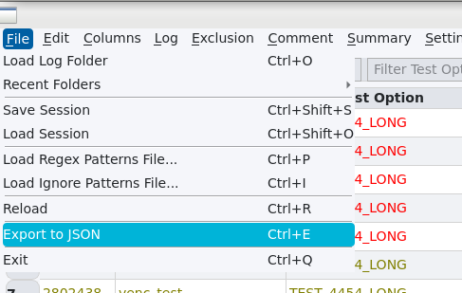
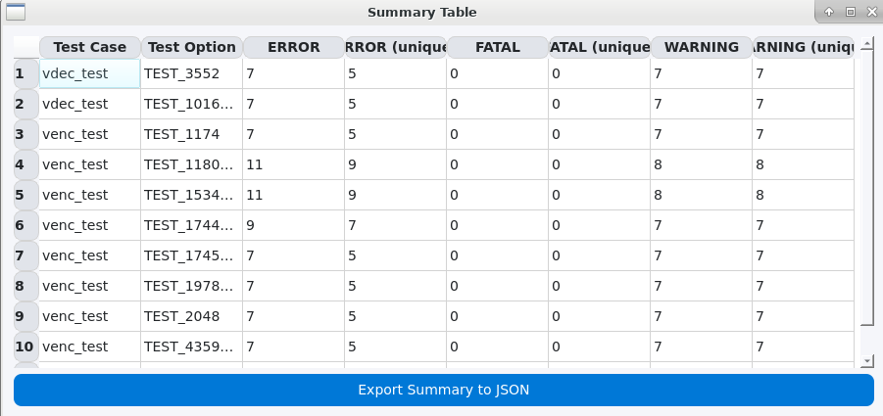
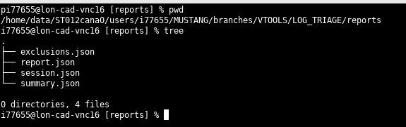
Export & Import
Export filtered/selected rows, summary details and exclusion to JSON
You can import exclusion to the other regression DB, to ease of filtering known Error/Warnings
You can load the sessions, for the collaborative works
You can export the table in json format
You can export the summary in json format
Created json files from the tool

Slide 18
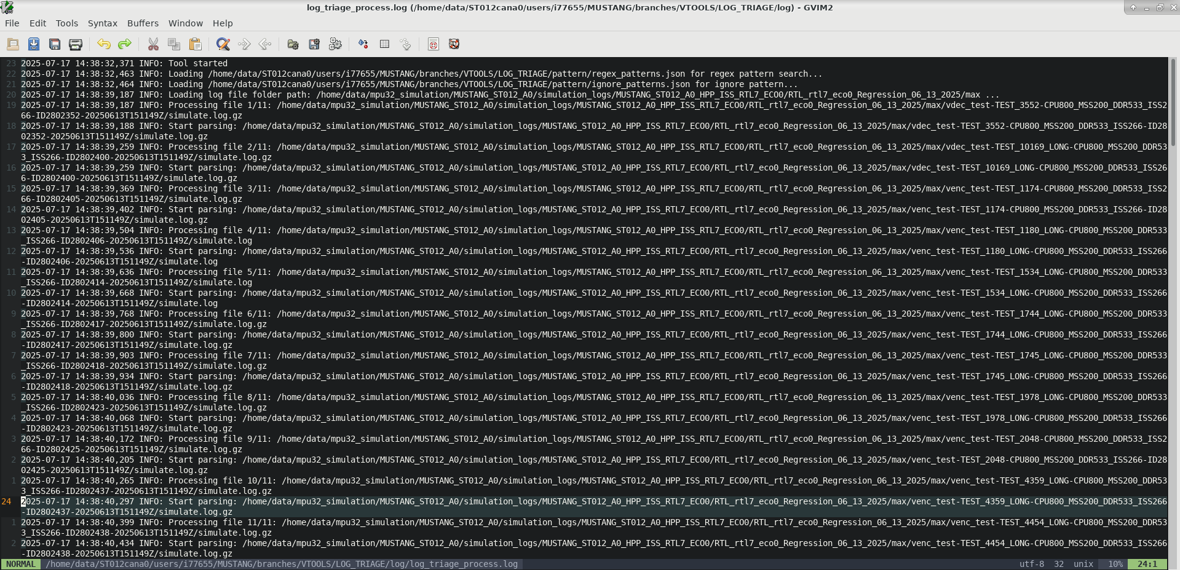
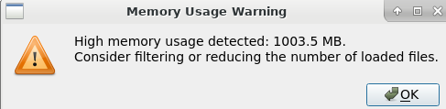
Troubleshooting
Real-time logging to file and console
Custom exception handler with GUI alerts
Logs stored in 'log_triage_process.log'
FlushFileHandler ensures immediate log writes
High Memory usage warning (>1GB)

Slide 19
Future Ideas to Consider, Any Suggestions?
Tagging System: Allow users to tag log entries for categorization.
Auto-Triage Suggestions: Use simple heuristics or ML to suggest likely causes or group similar issues.
Integration Hooks: Allow integration with bug tracking tools (e.g., JIRA) or CI/CD pipelines.
Command Line Interface (CLI): For users who prefer scripting or automation.
Your feedback and suggestions for improvement are most welcome.

Slide 20
Thank You
Johnson Amalraj

